Slide 1
#04 File I/O, Object Streams and Exceptions
Notes:
Give an explanation for file I/O, object streams and exceptions
Relevant theoretical decisions
What is the purpose of data files and how is it used in a C# program?
Name some common file types used for storing data
How can you store and load objects on files?
What is exception handling?
Is it necessary to handle exceptions in a C# program?
What is the difference of caught and uncaught exception?
How can exception in a C# program be handled?

Slide 2
Class

Slide 3
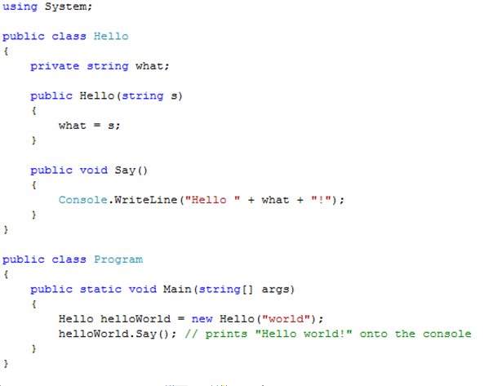
Class Example and Visibility

Slide 4

Interfaces
“An interface is a contract that guarantees to a client how a class will behave”
A Class can implement more the one interface
Interfaces can be extended and combined

Slide 5
Abstract Class

Slide 6
Abstract Class Vs Interface

Slide 7
Garbage Collector
C# performs automatic garbage collection
Collection/removing objects that are marked as garbage
Object that no longer has a reference
C# programmers don’t need to worry about explicitly reclaiming memory that has become garbage

Slide 8
Use in our program

Slide 9
Use in our program

